Slide 1
Cloudflare Full-page Caching for Umbraco Websites
Nurhak Kaya

Slide 2
Agenda
Introduction
What is Cloudflare and how does it work?
Cloudflare setup and key features
Cloudflare page rules and caching
Integrating Umbraco with Cloudflare
Q&A

Slide 3

Introduction
Hi! My name is Nurhak Kaya.
Technical Architect and Lead Developer
Umbraco MVPx2, Umbraco Certified Master
Umbraco CMS Community Team Member
Author of multiple Skrift and 24 Days in Umbraco blog articles
Contributes to Umbraco CMS and open-source projects by writing blogs, answering questions, organising events, speaking at events, working on PRs etc.

Slide 4
Before we start...
How many of you have used Cloudflare before?
How many of you have created CF page rules for full-page caching?

Slide 5
What is Cloudflare and how does it work?

Slide 6
What is Cloudflare?
It is a CDN (Content Delivery Network).
A CDN is geographically distrubuted group of servers that caches content close to end users.
It allows for the quick transfer of assets needed for loading internet content, including;
HTML pages,
JavaScript files,
Stylesheets,
Images,
Videos
Major websites use CDN, like Facebook, Netflix, and Amazon.
If configured correctly, it can protect websites against some common malicious attacks, such as DDoS attacks.
A CDN is NOT the same as a web host and it can not replace it.
It does help cache content at the network edge to improve the performance and security.

Slide 7
What are the benefits of using a CDN?
Primary benefits are;
Improving website load times by distributing content close to website visitors by using a nearby CDN server.
A UK web user is served using a UK CDN server.
A US web user is served using a US CDN server.
Reducing bandwidth costs through caching and optimizations.
Cached content is served by the CDN server.
Non-cached content is served by the origin.
Increasing content availability and redundancy
Due to the distrubuted nature of CDNs, they can handle more traffic and withstand hardware failure better than many origin servers.
Improving security by DDoS mitigation, bot management, security certificates and optimisations.

Slide 8
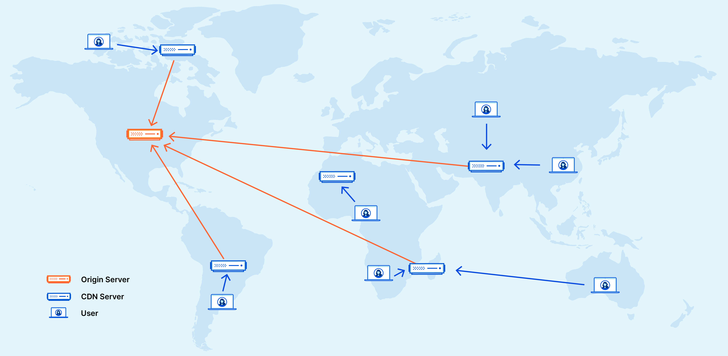
How does a CDN work?
A network of servers linked together with the goal of delivering content as quickly, cheaply, reliably, and securely as possible.
It places servers at the exchange points between different networks.
These are called Internet Exchange Points (IXPs).
They are primary locations where Internet providers connect.

Slide 9
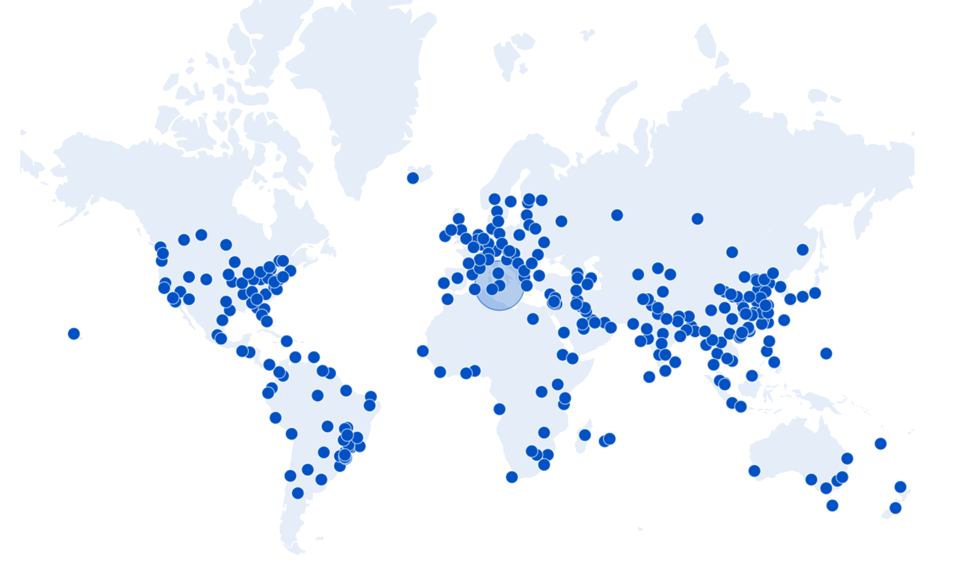
The Cloudflare global network
The CF network can reach about 95% of the world’s population within approximately 50 ms.
Data Centre Locations
North America
Latin America & the Caribbean
Africa
Europe
UK centres are in London, Edinburgh and Manchester.
Middle East
Asia
Mainland Chine
Oceania

Slide 10
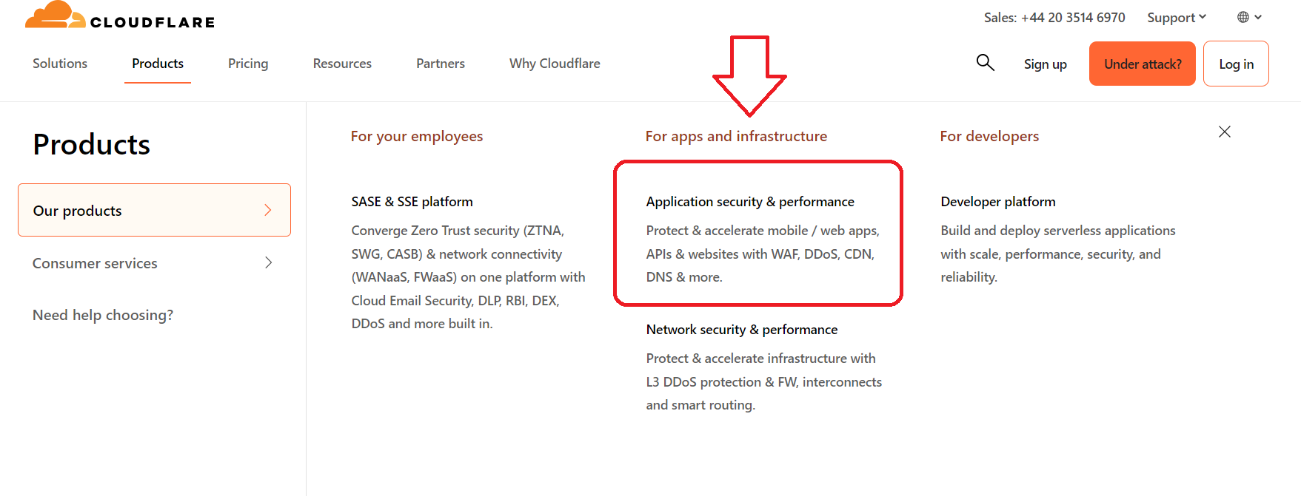
Cloudflare products

Slide 11
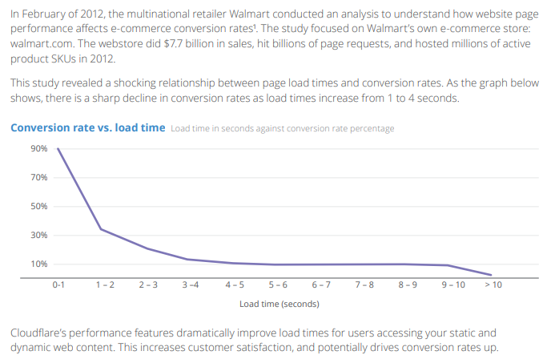
Cloudflare case study
https://www.cloudflare.com/resources/images/slt3lc6tev37/6mpY5zjlPP3b2twznUQOki/b221bc7b49723deb2c09a4b30747f685/cloudflare-cdn-whitepaper-19Q4.pdf

Slide 12
Cloudflare setup in 6 steps

Slide 13
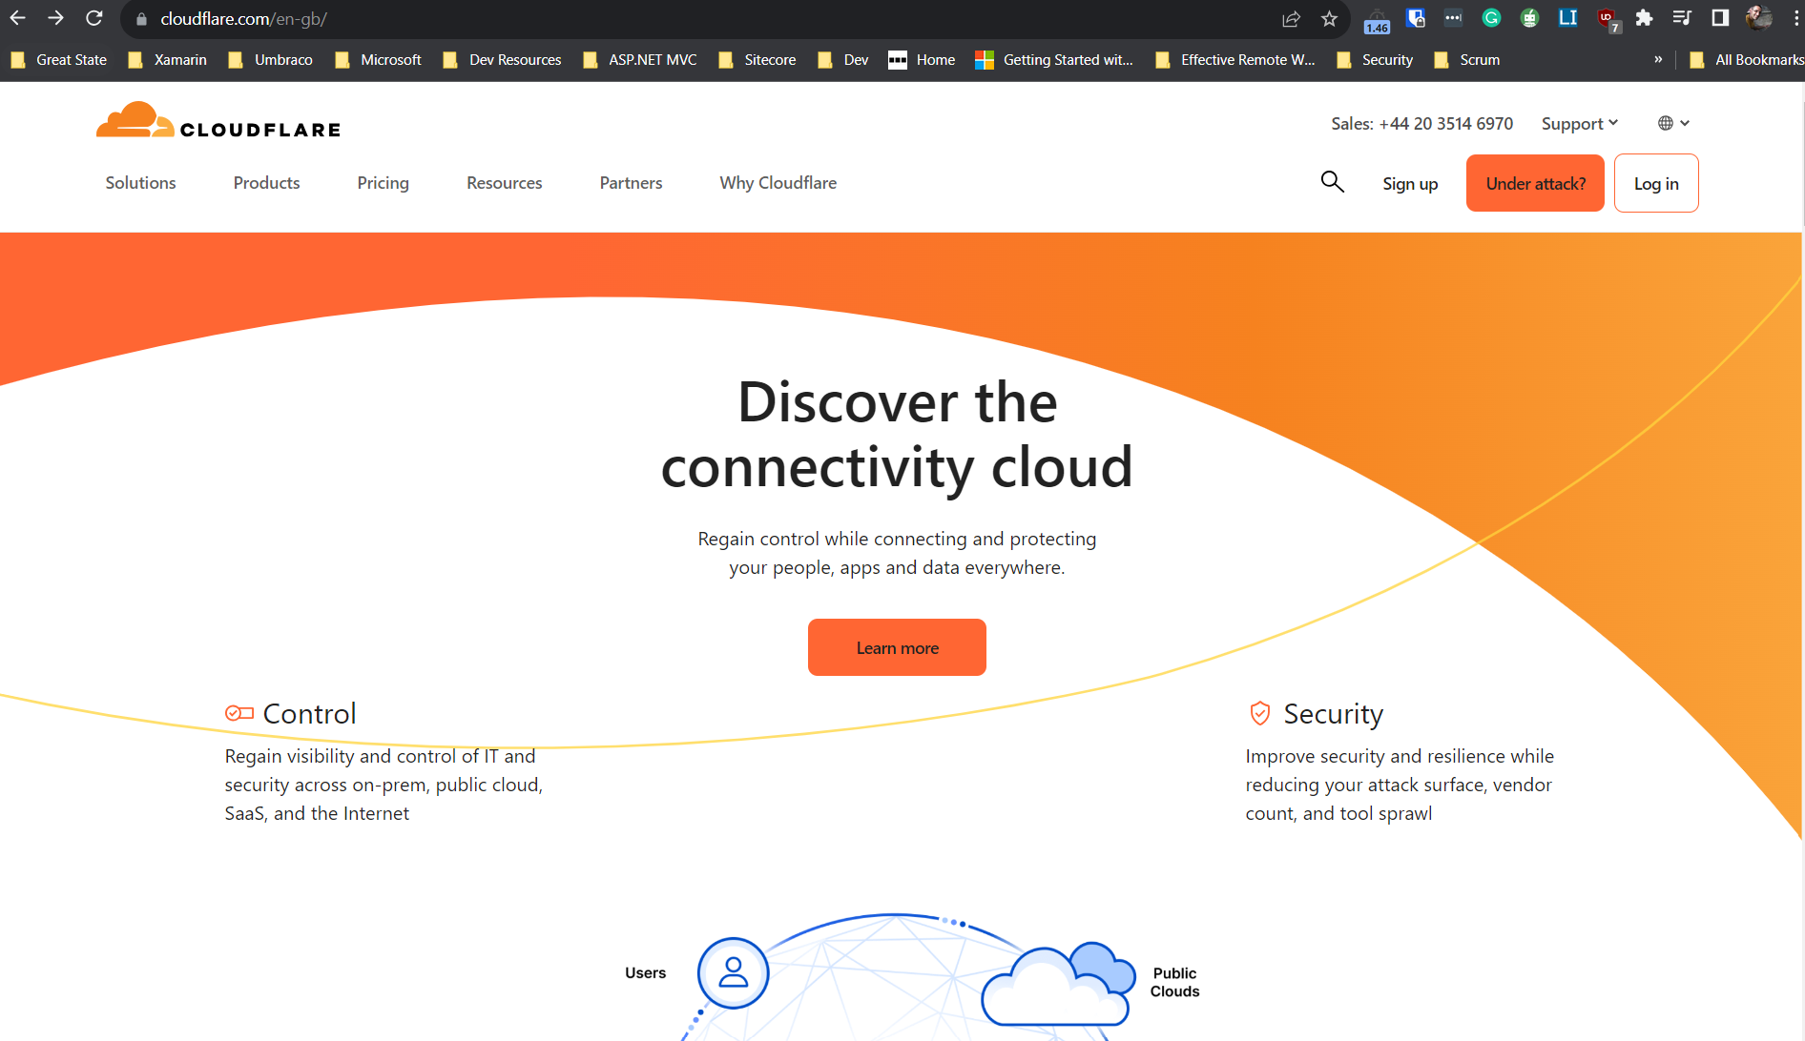
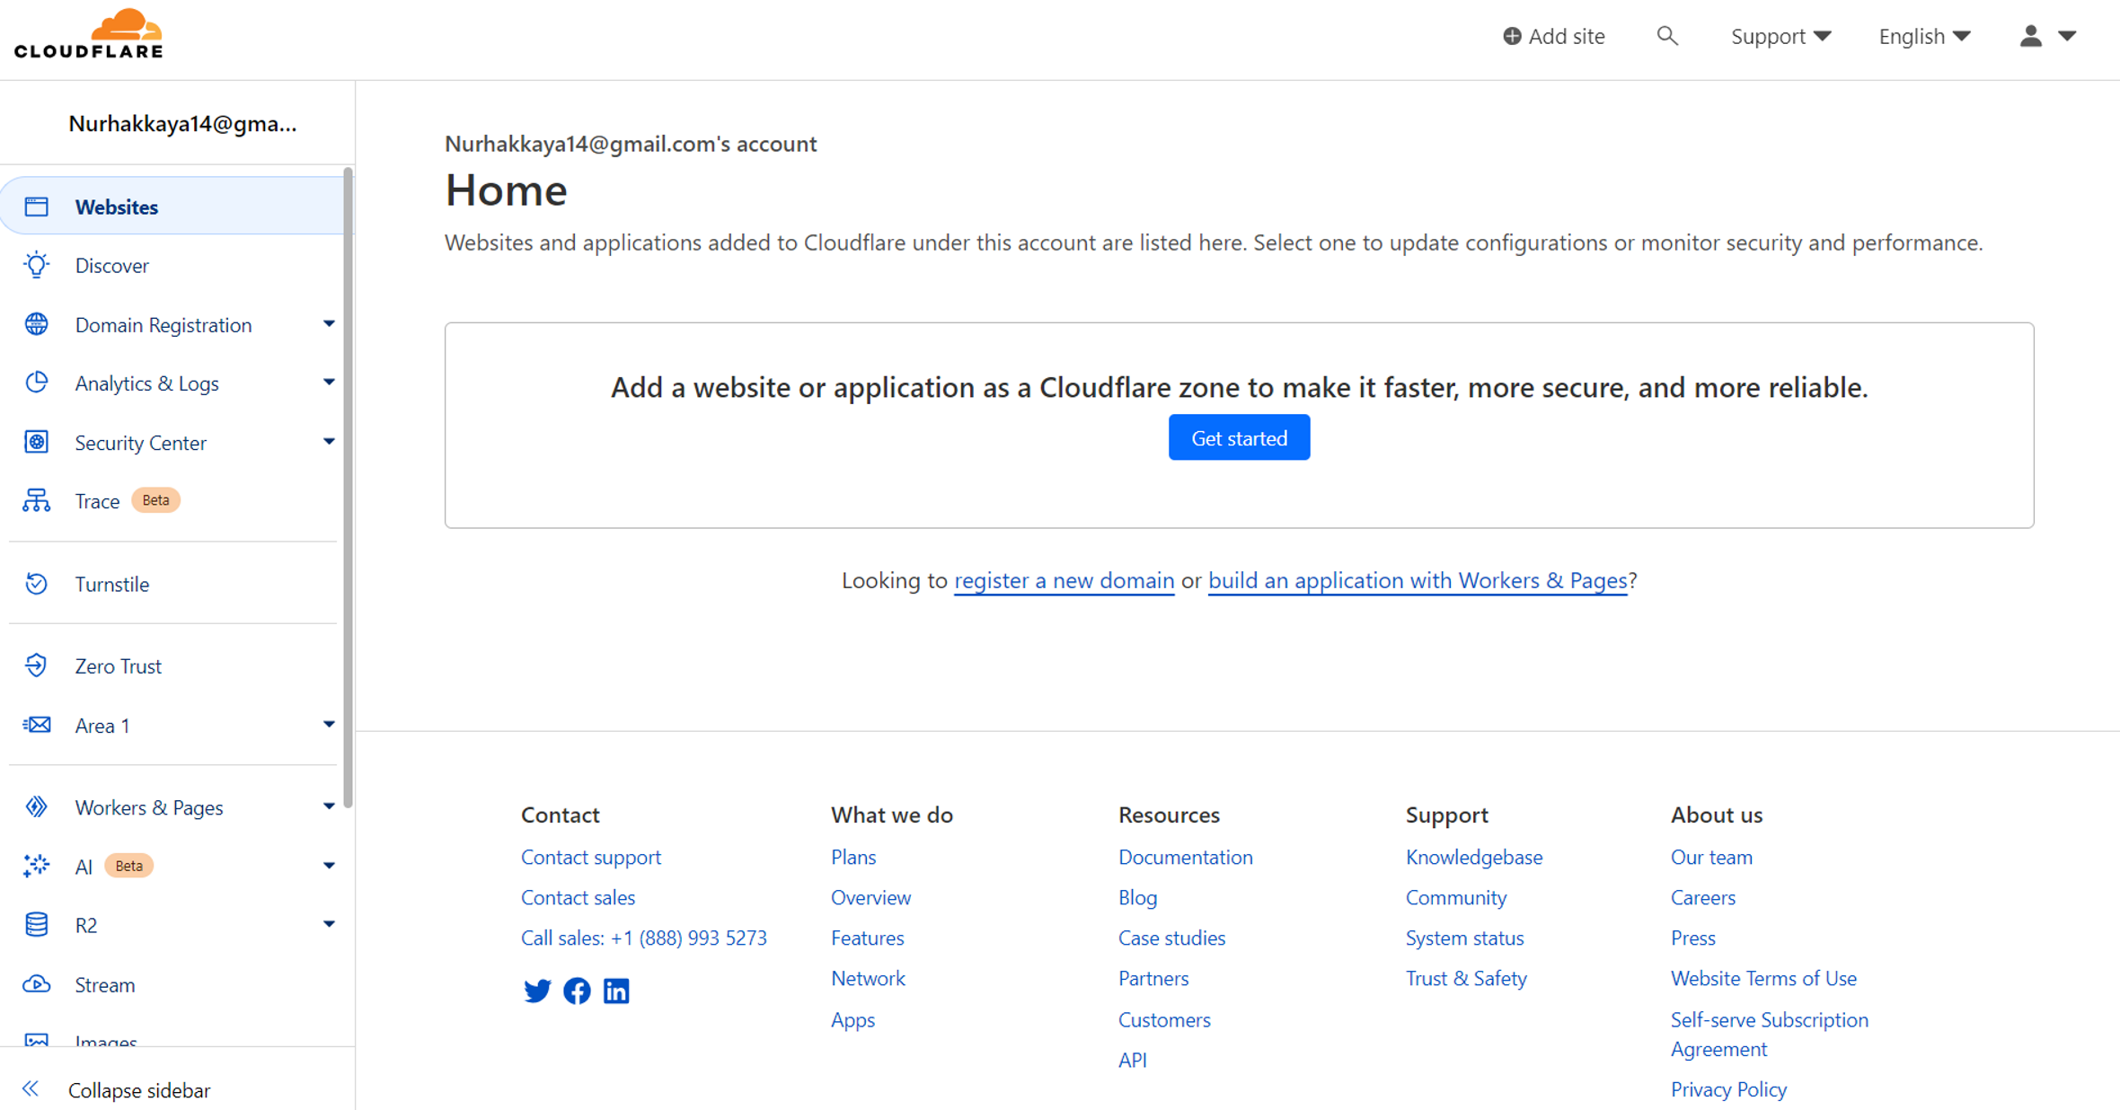
Step 1 – Sign up / Log in

Slide 14
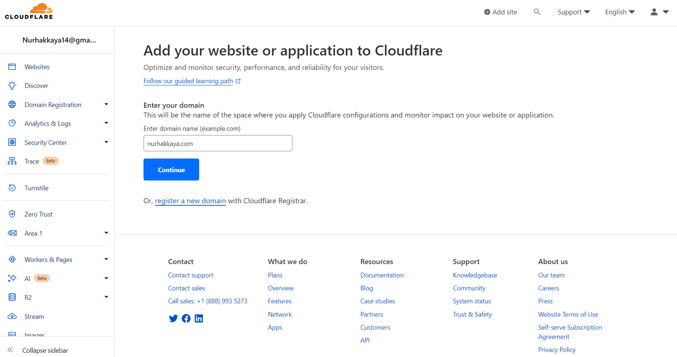
Step 2 – Add your website

Slide 15
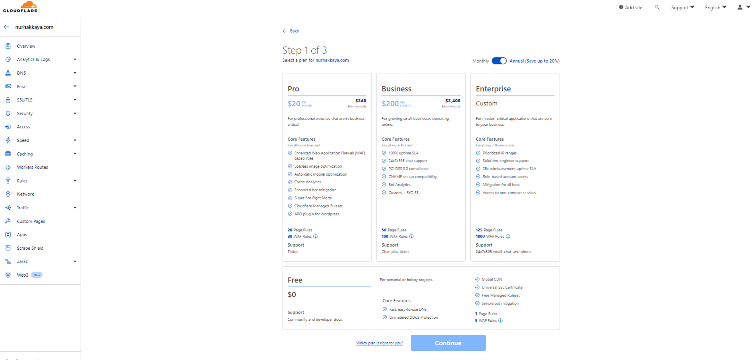
Step 3 – Choose your plan

Slide 16
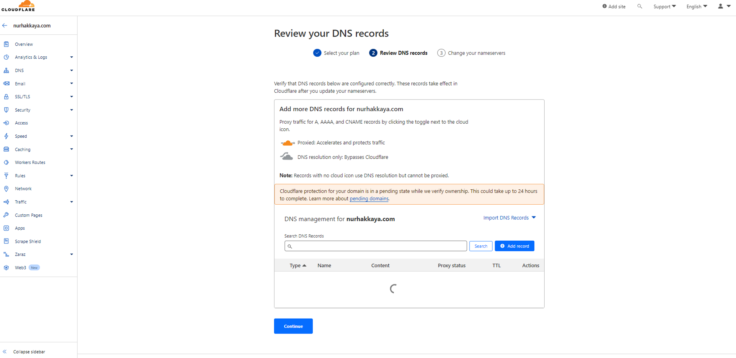
Step 4 – Review your DNS records

Slide 17
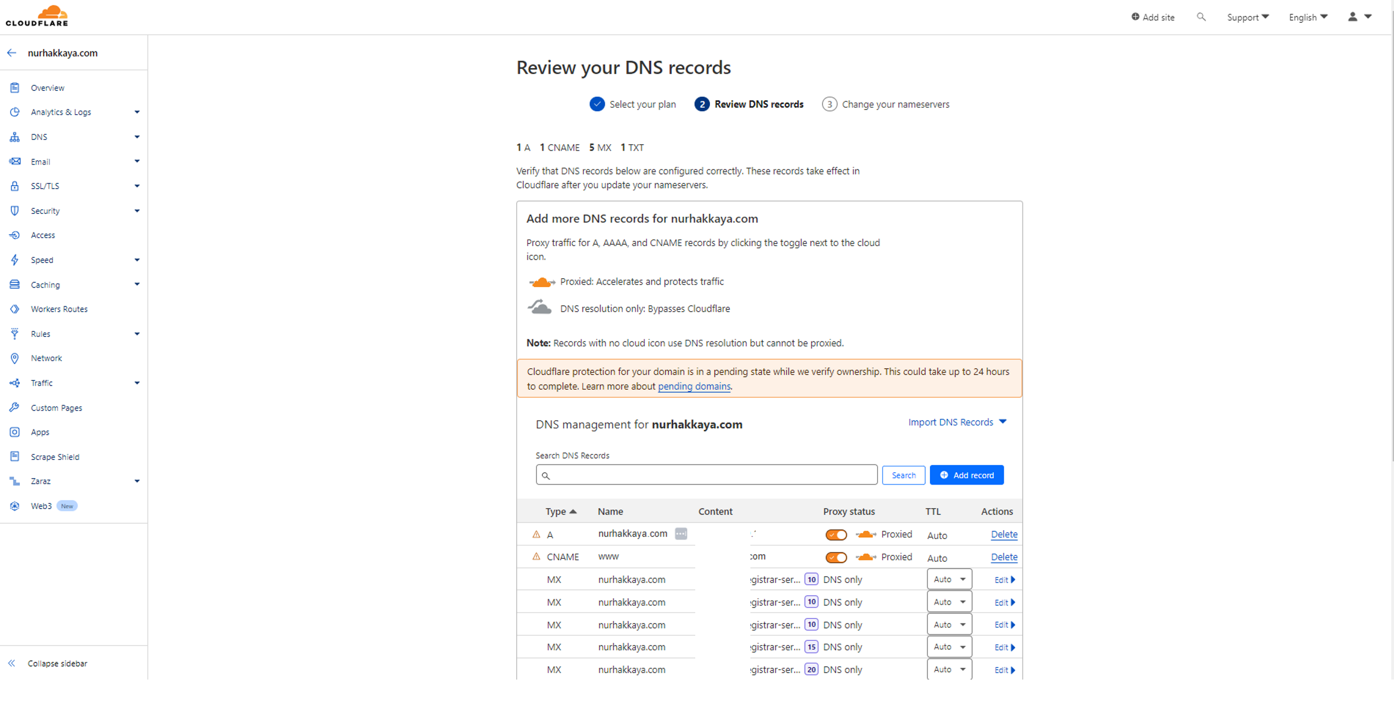
Step 4 – Review your DNS records

Slide 18
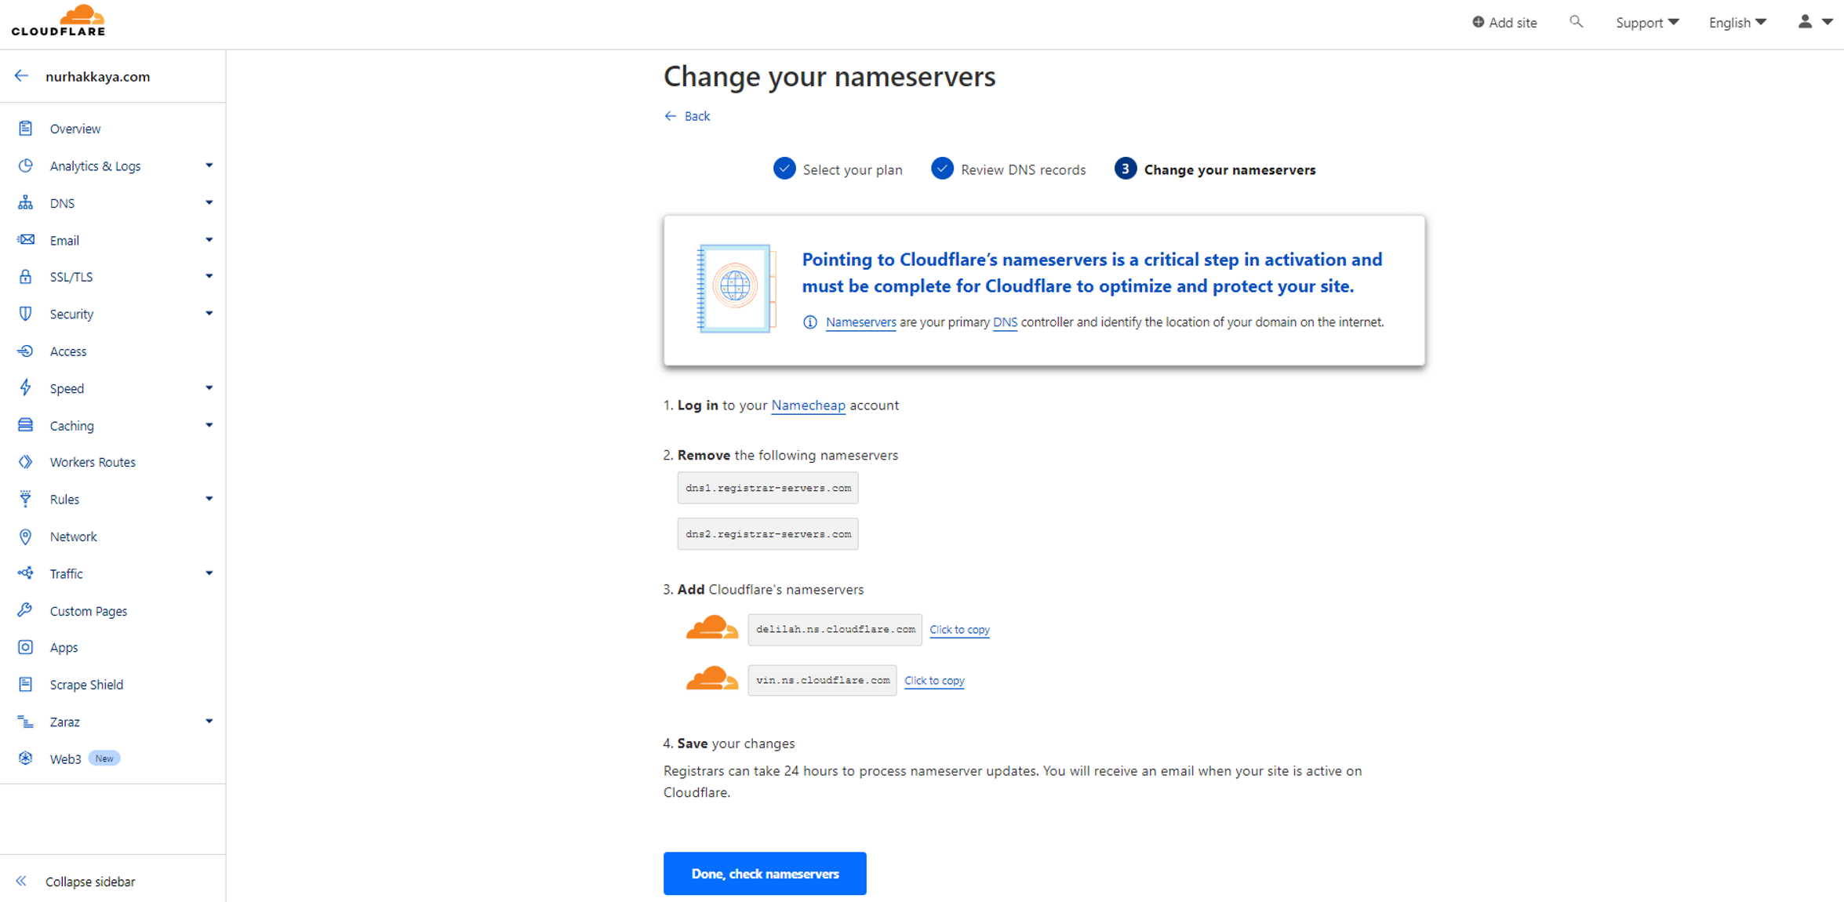
Step 5 – Add CF’s nameservers

Slide 19
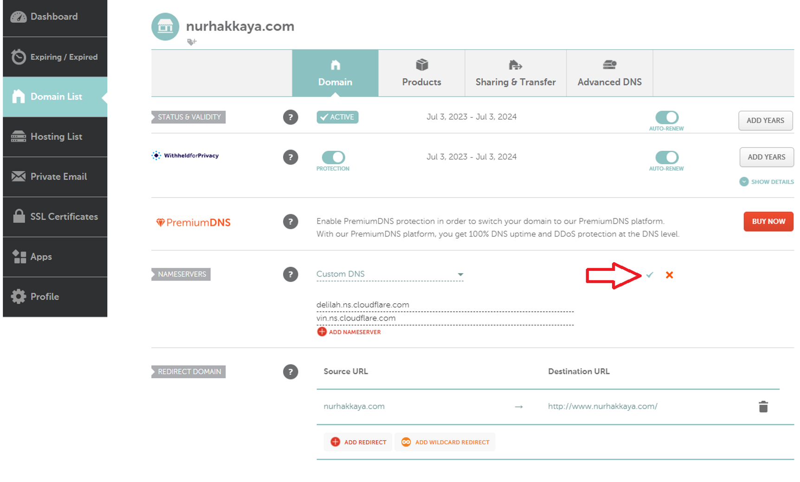
Step 5 – Add CF’s nameservers

Slide 20
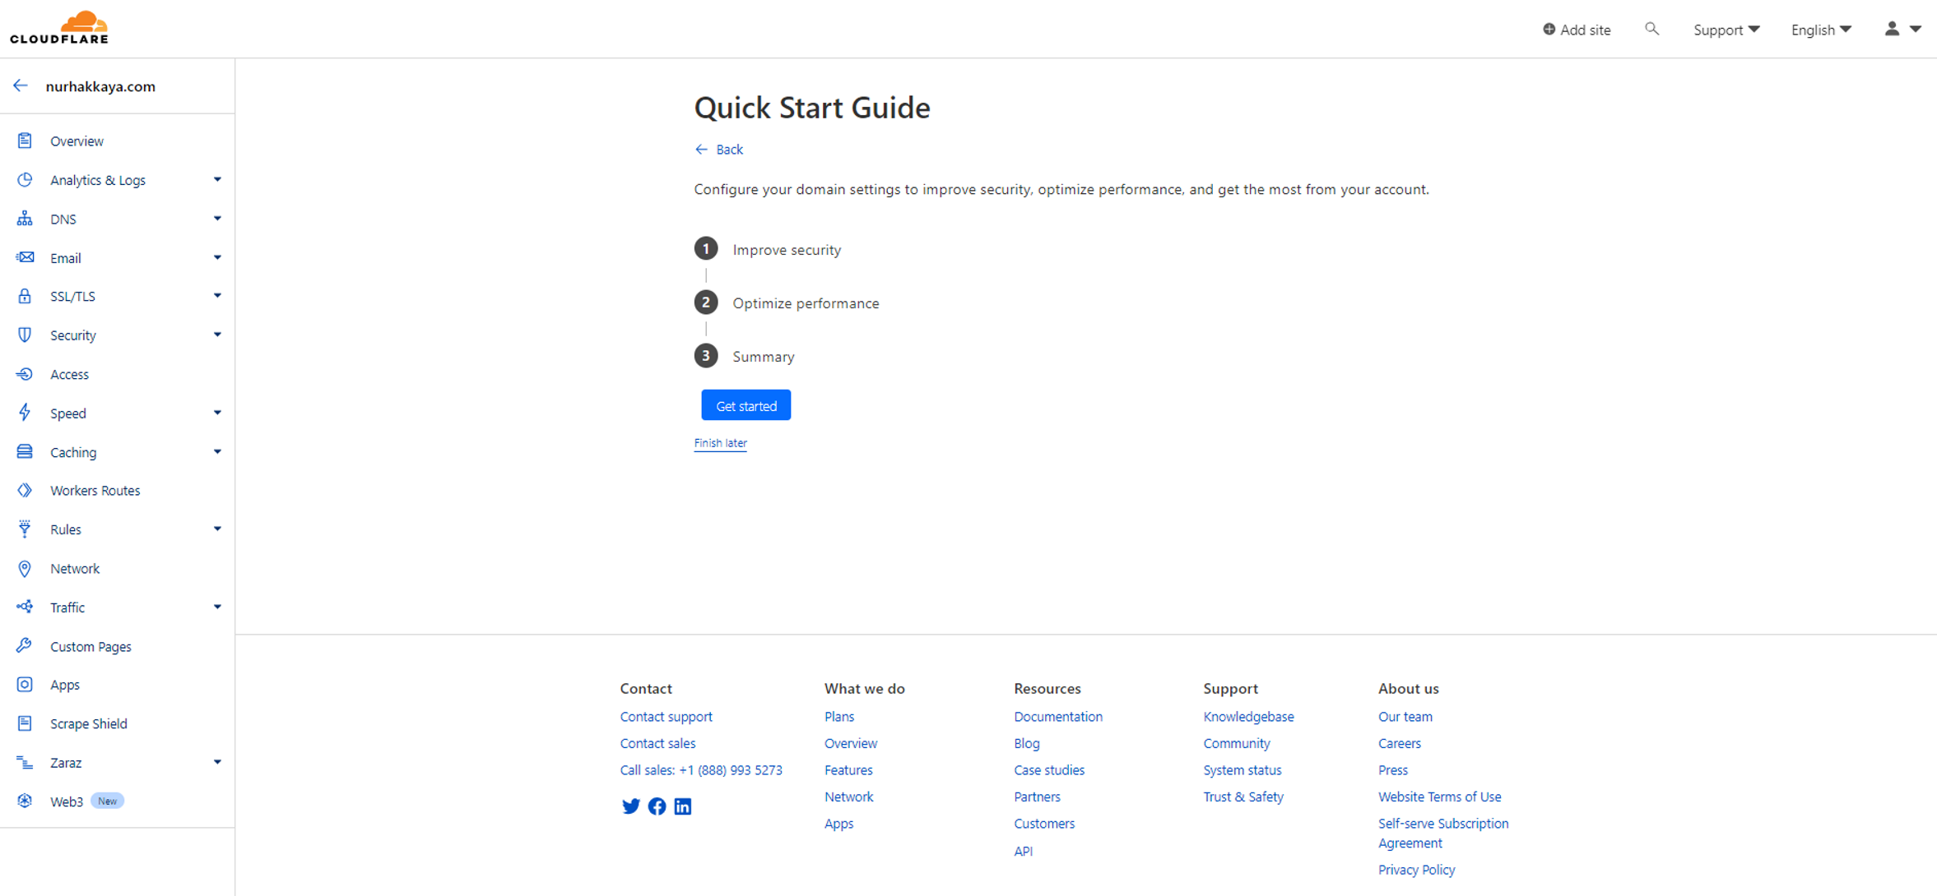
Step 6 – Configure your CF settings

Slide 21
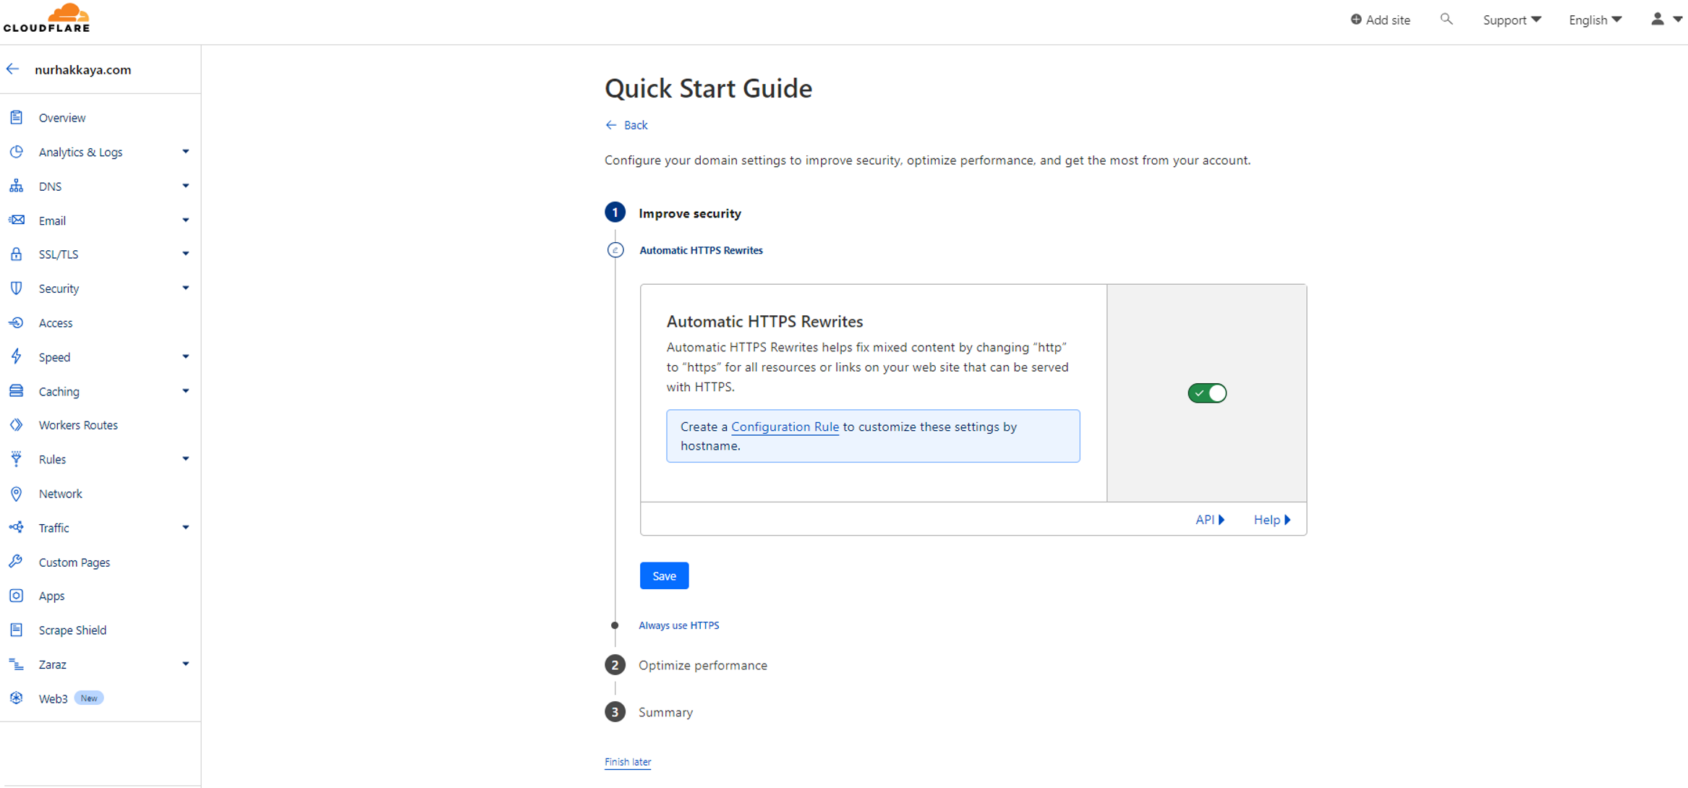
Step 6 – Configure your CF settings

Slide 22
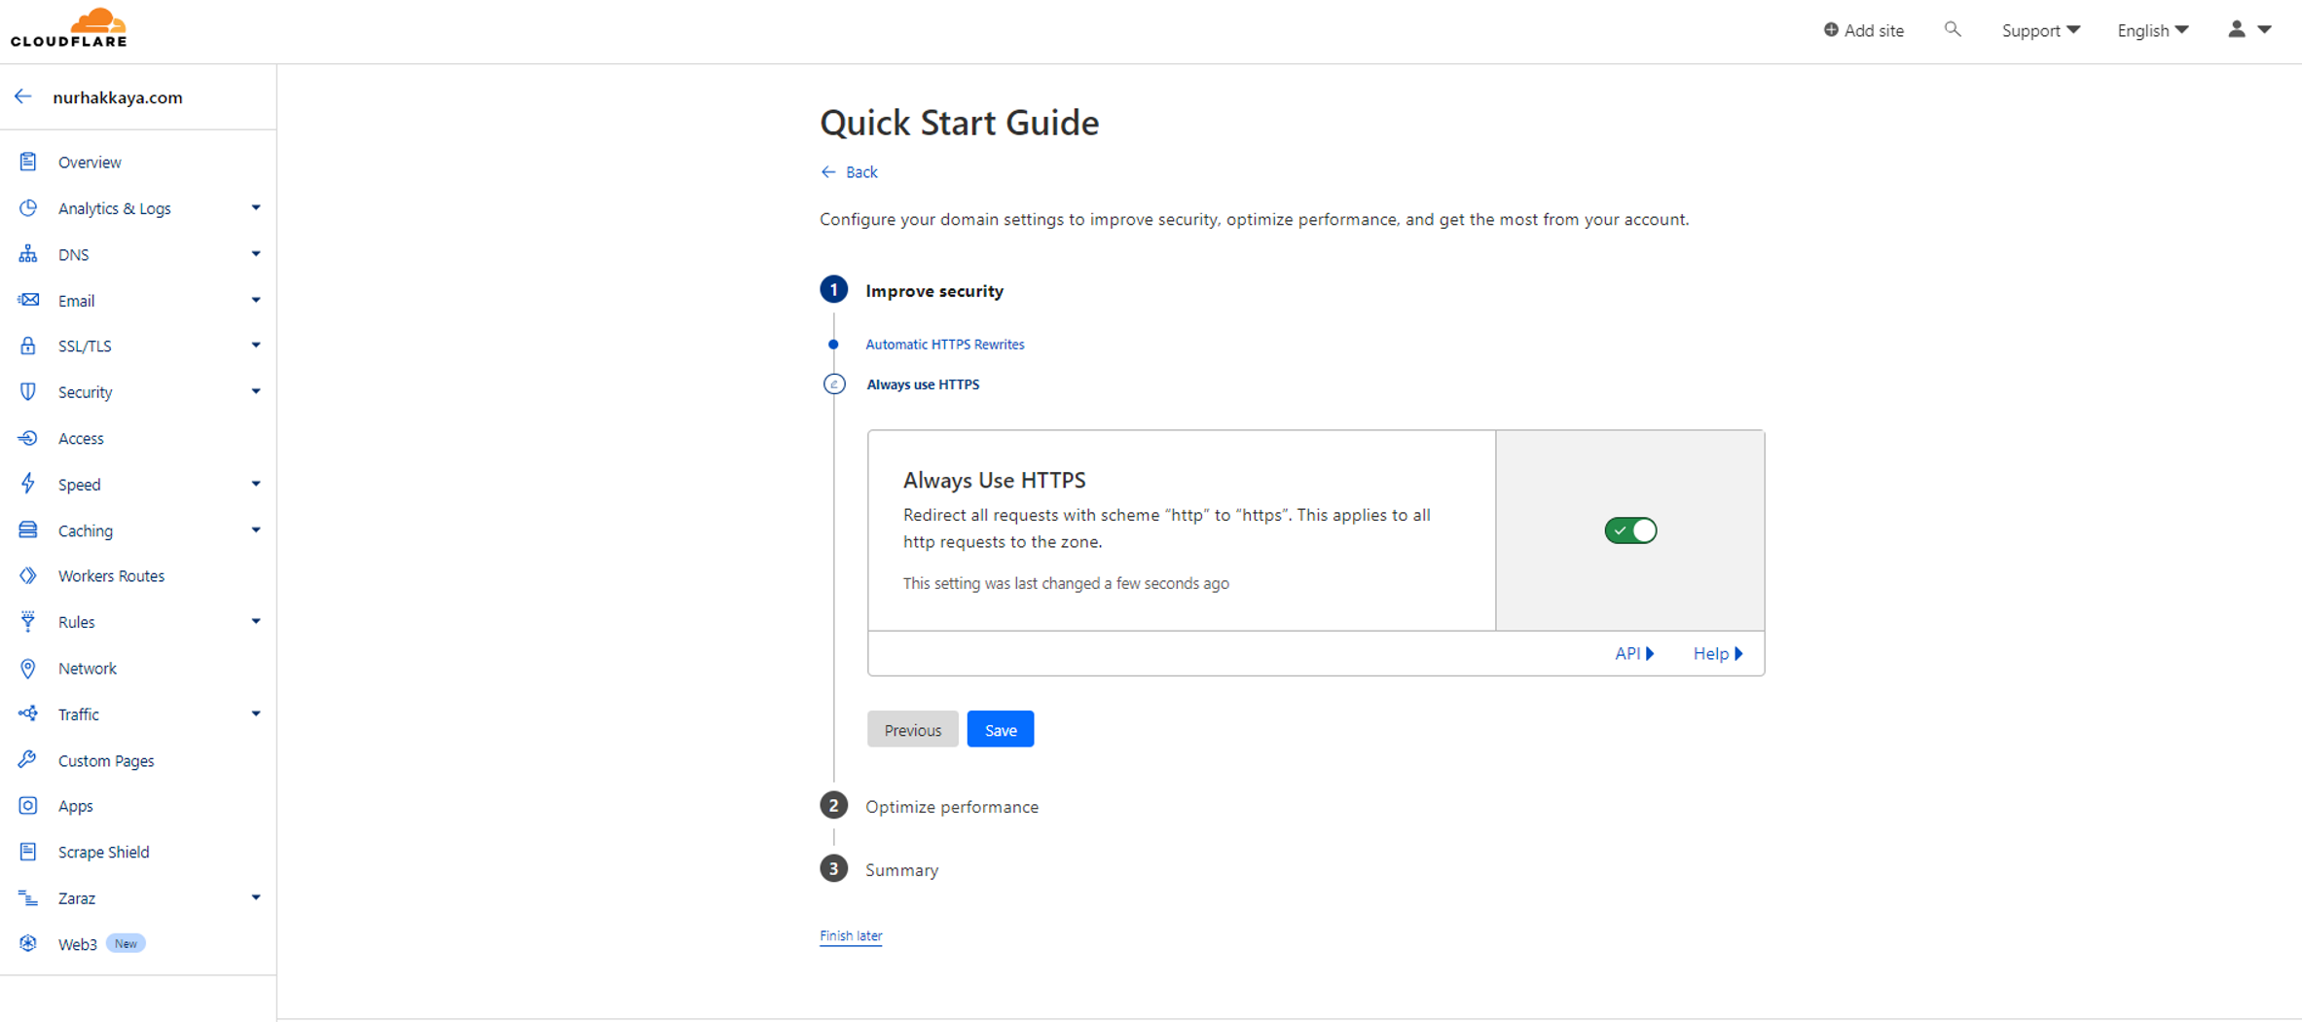
Step 6 – Configure your CF settings

Slide 23
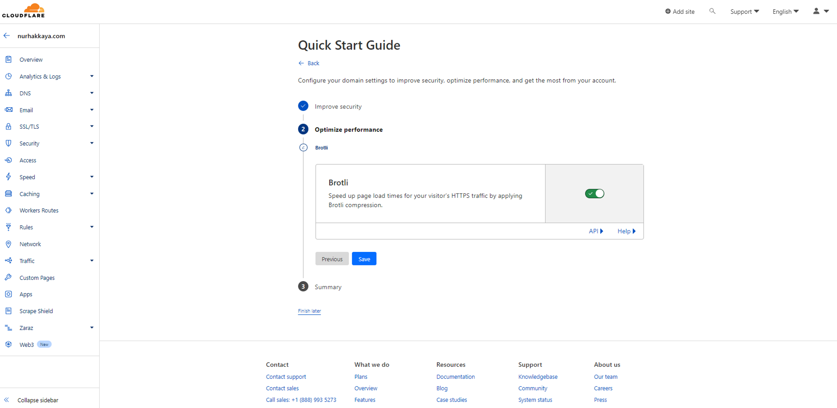
Step 6 – Configure your CF settings

Slide 24
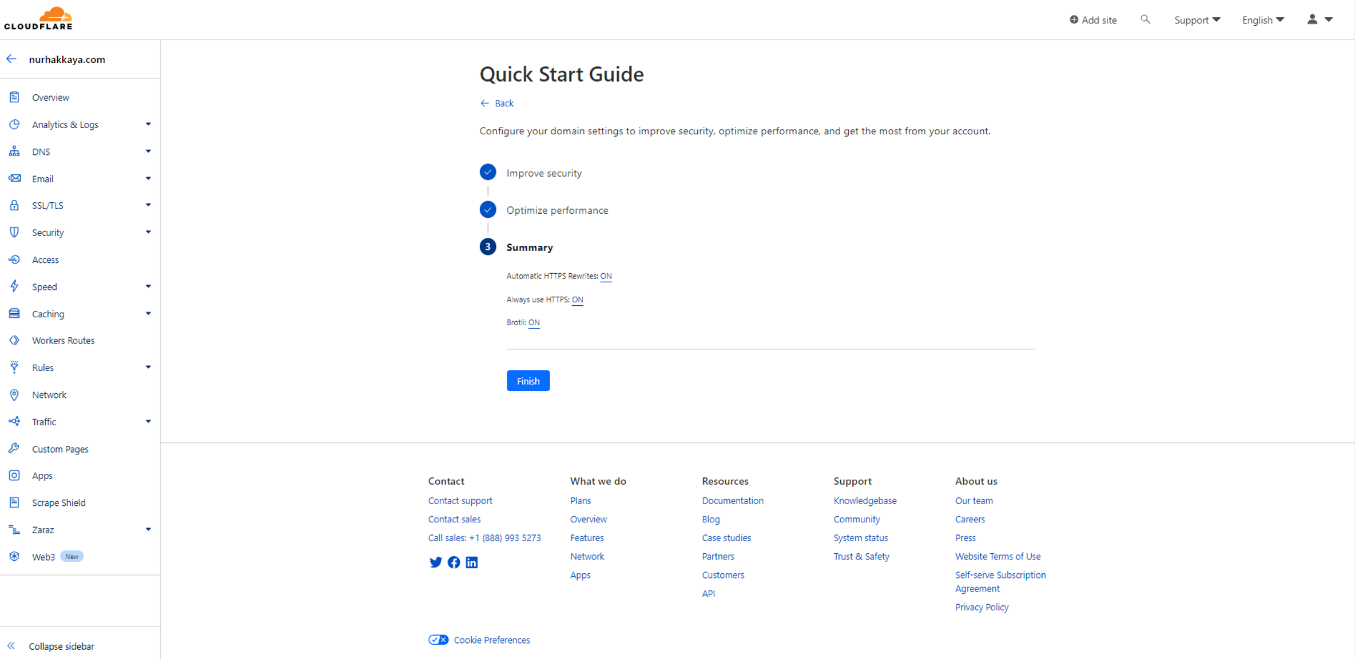
Step 6 – Configure your CF settings

Slide 25
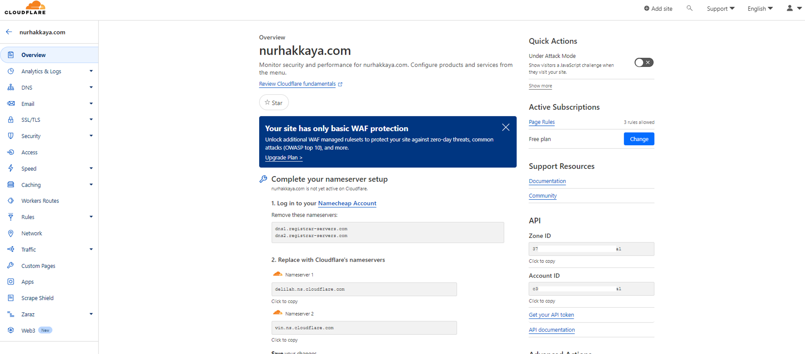
Step 6 – Configure your CF settings

Slide 26
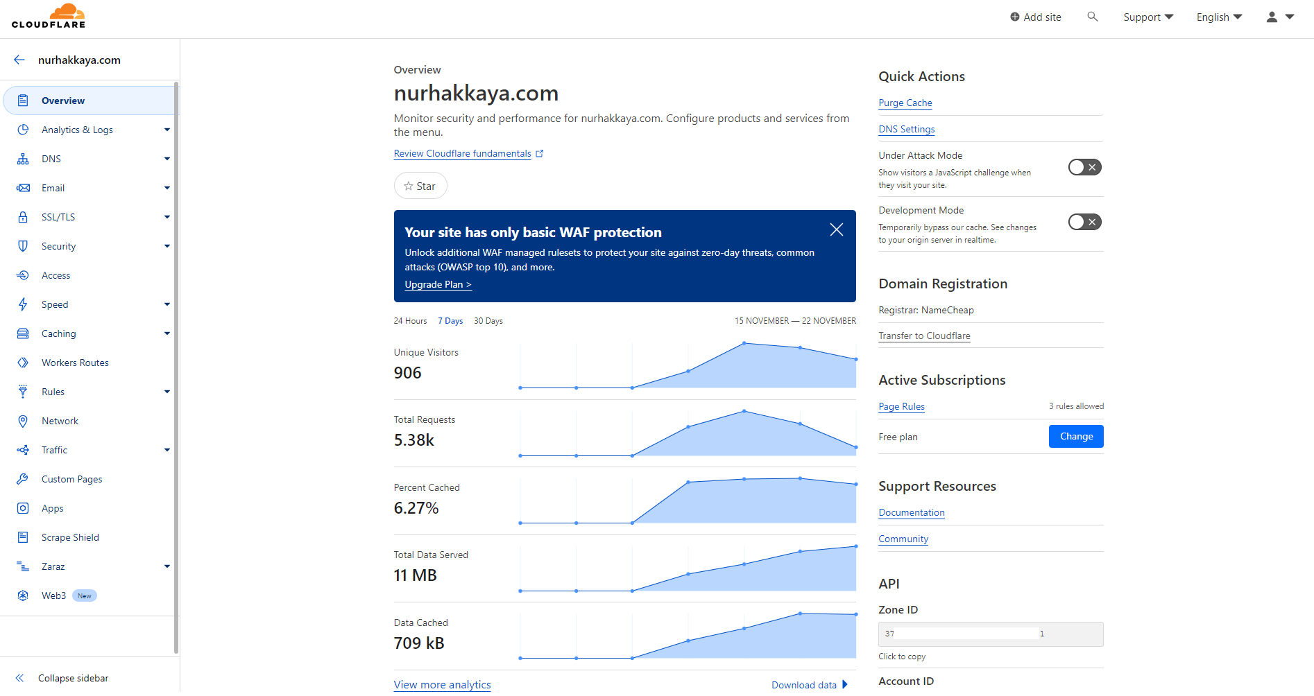
Final result

Slide 27
Cloudflare key features

Slide 28
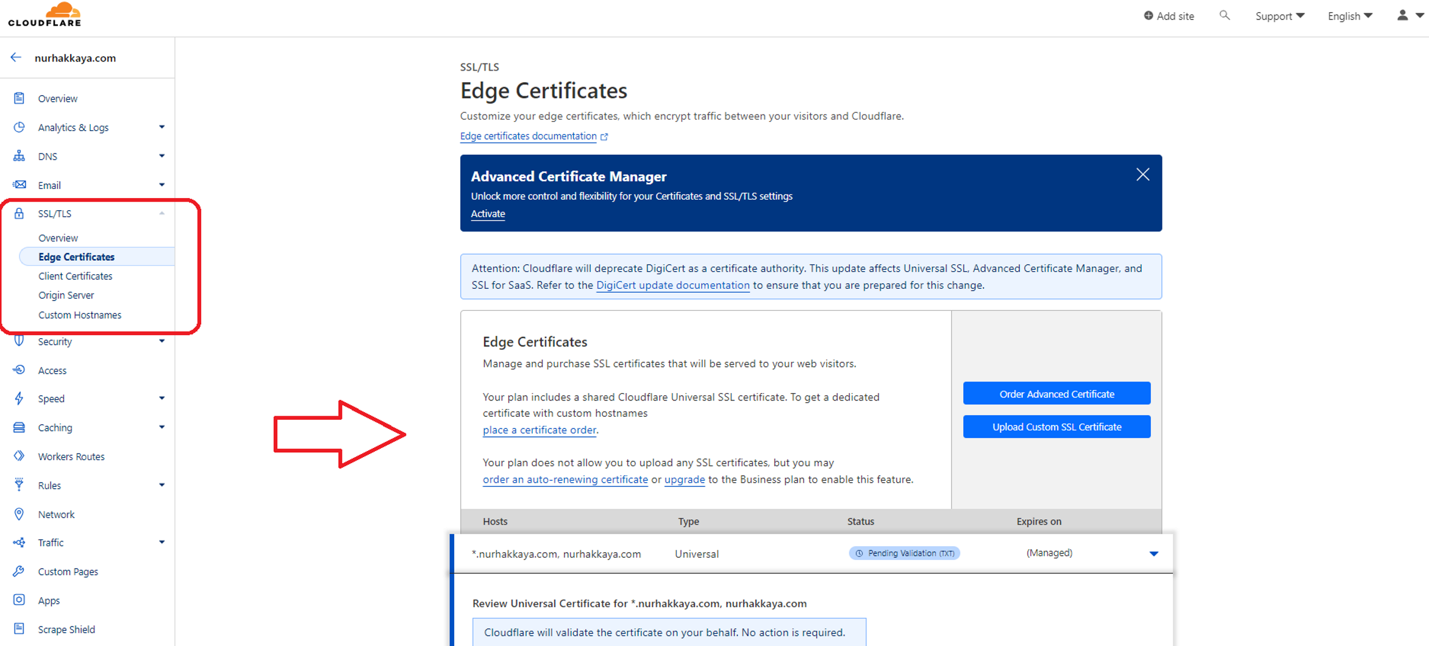
SSL/TLS

Slide 29
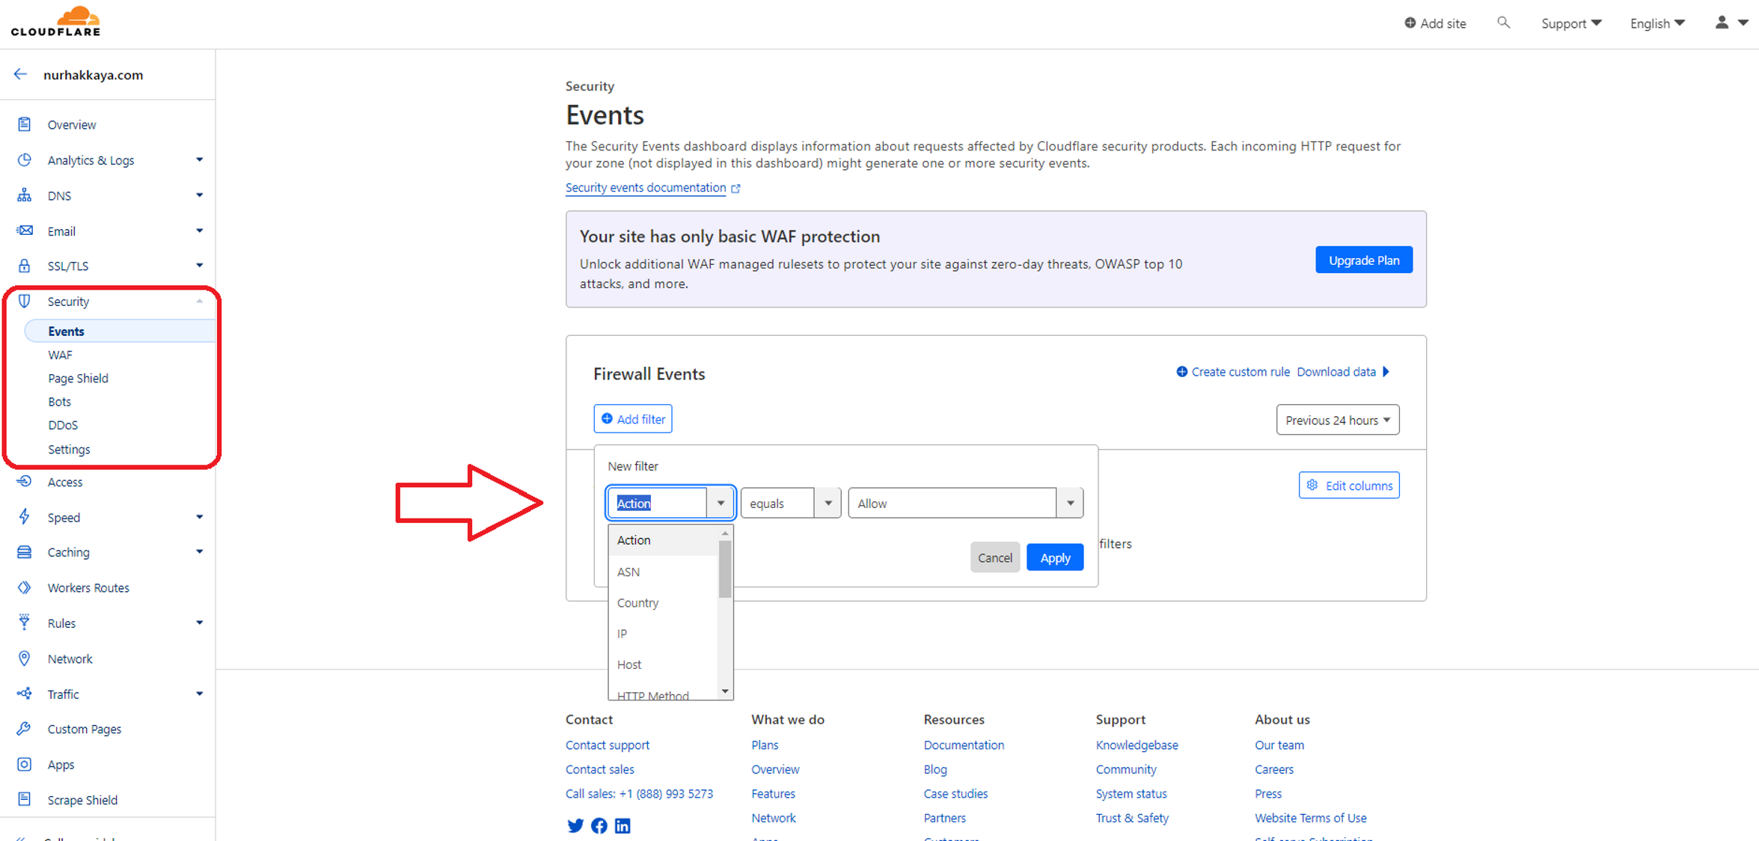
Security

Slide 30
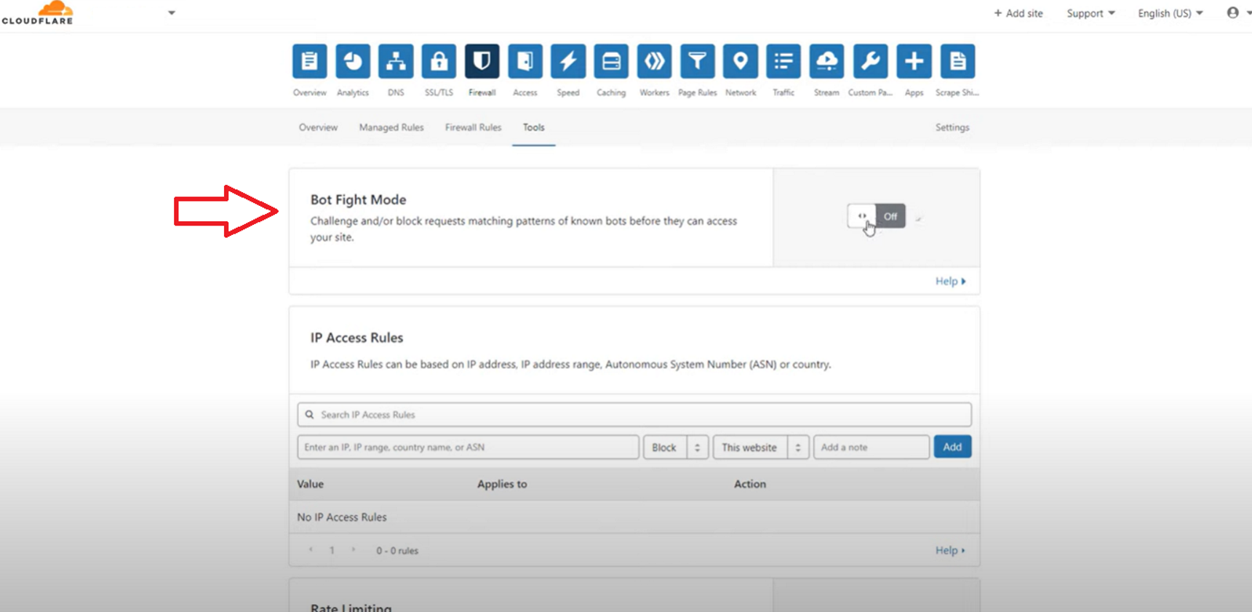
Security

Slide 31
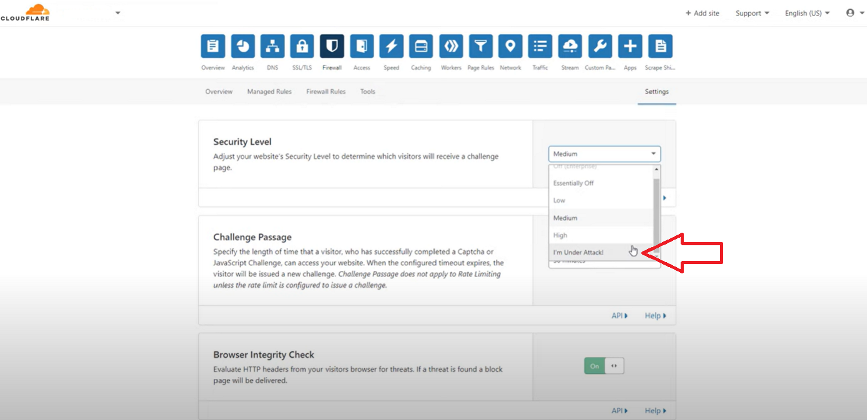
Security

Slide 32
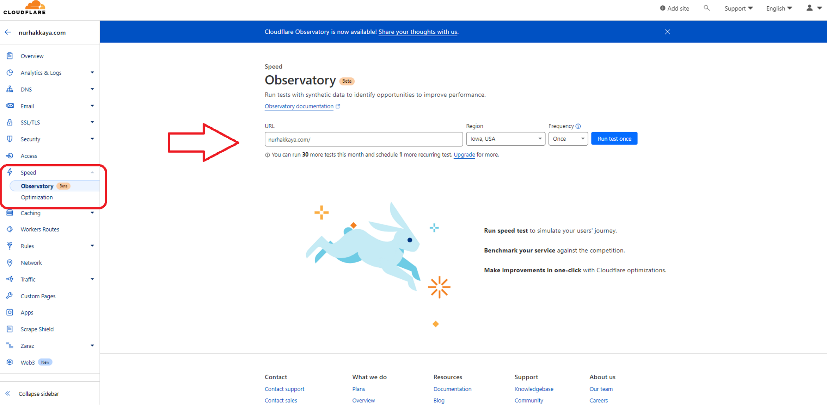
Speed

Slide 33
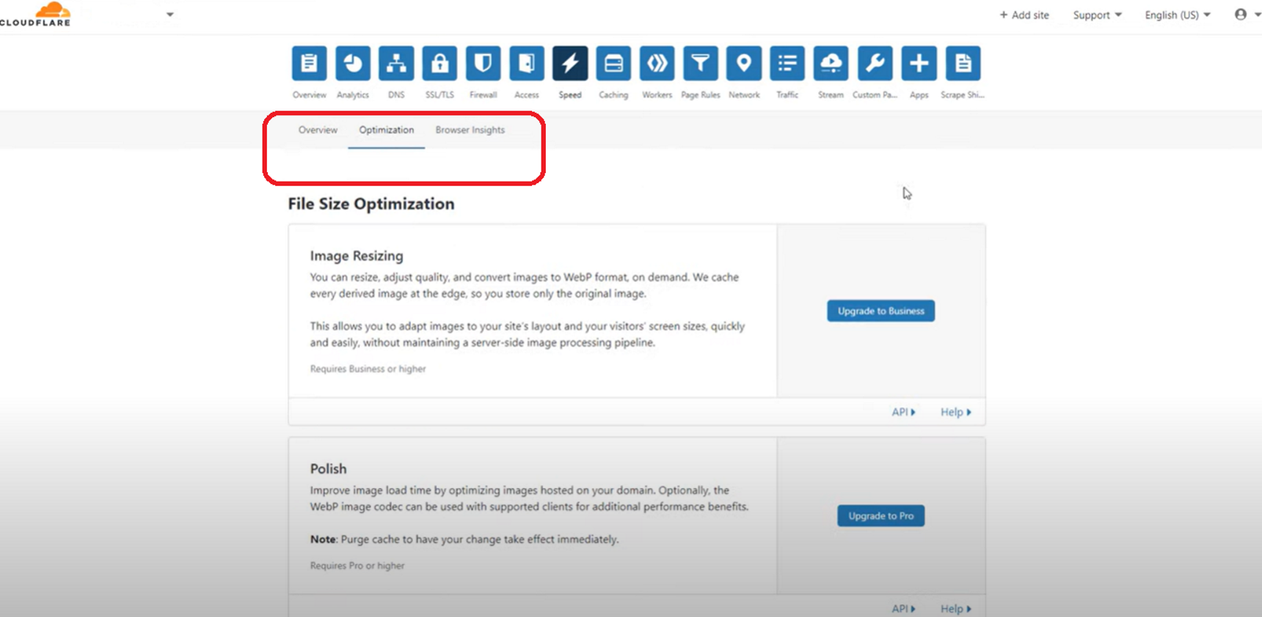
Speed

Slide 34
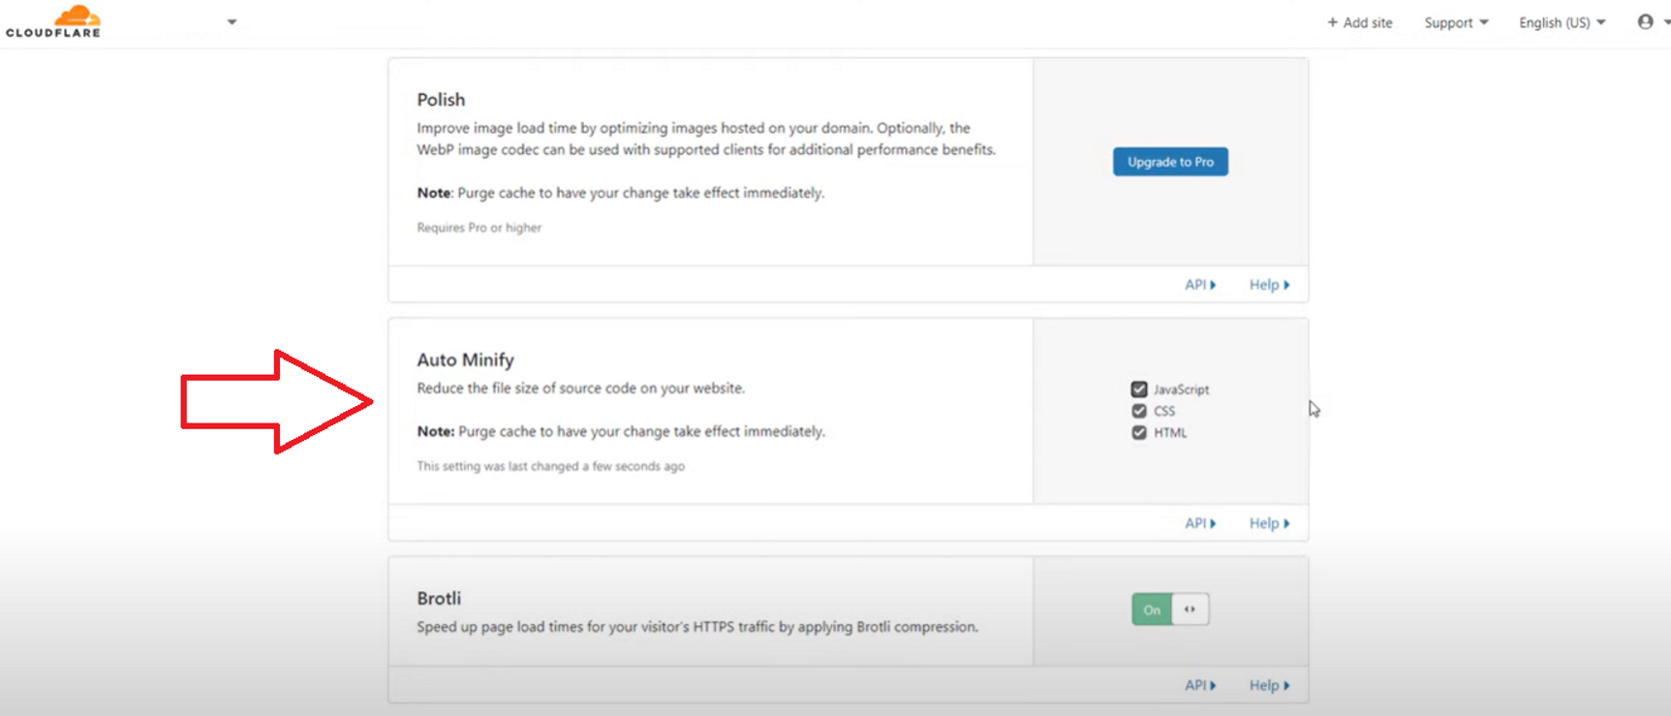
Speed

Slide 35
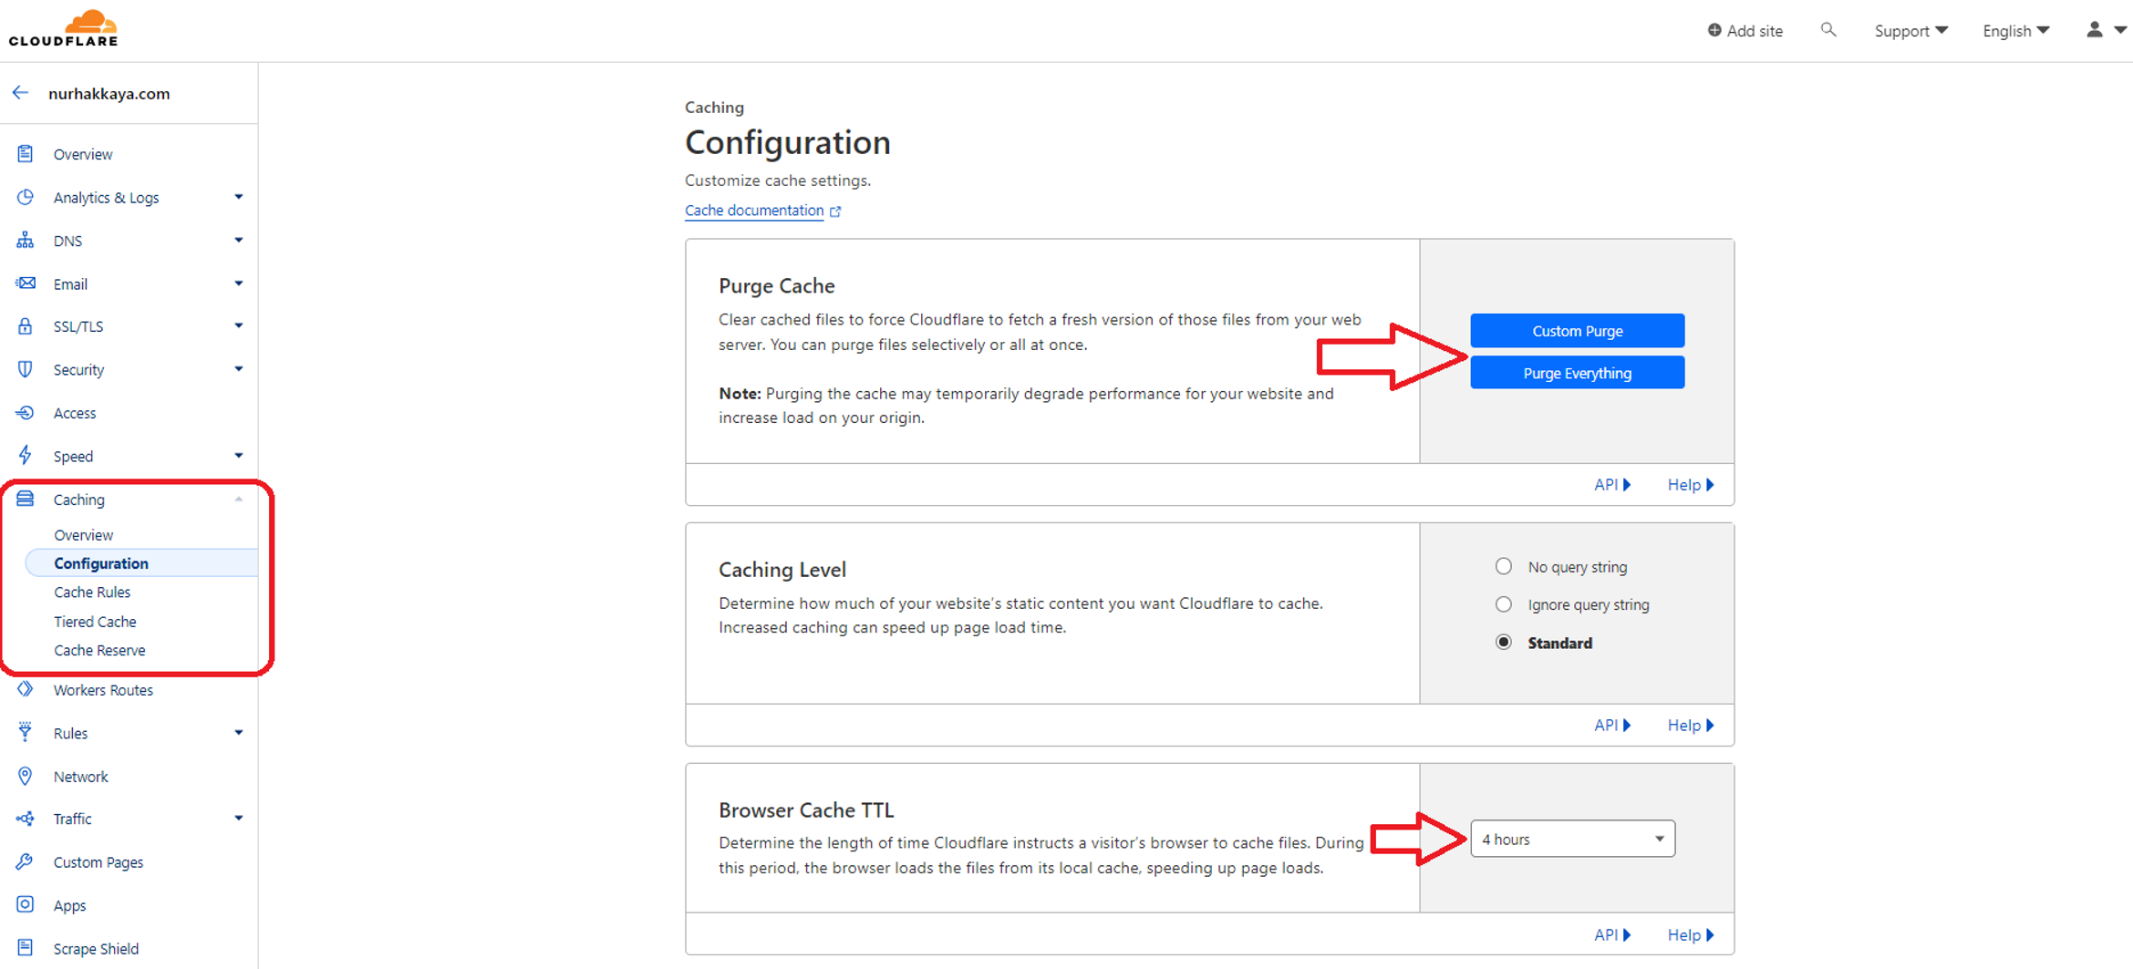
Caching

Slide 36
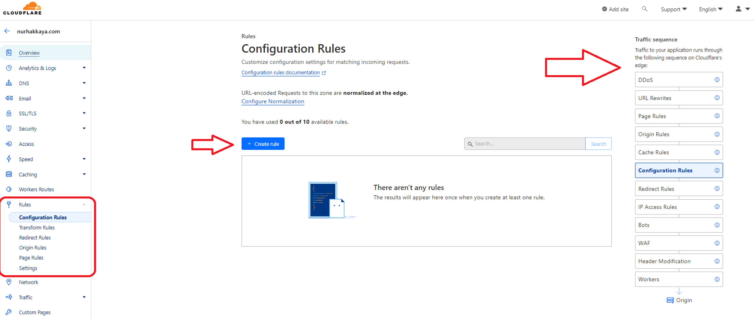
Rules

Slide 37
Cloudflare page rules and caching

Slide 38
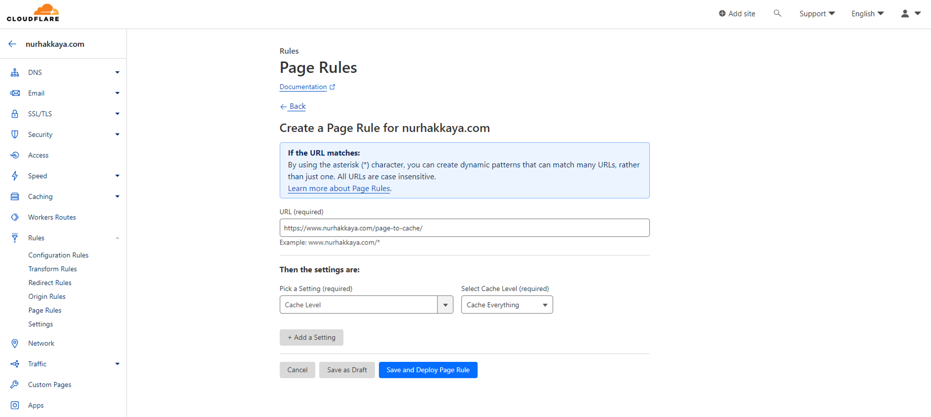
Page rule for full-page caching

Slide 39
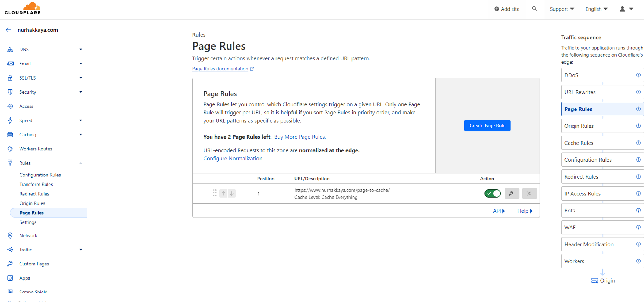
Page rules list

Slide 40
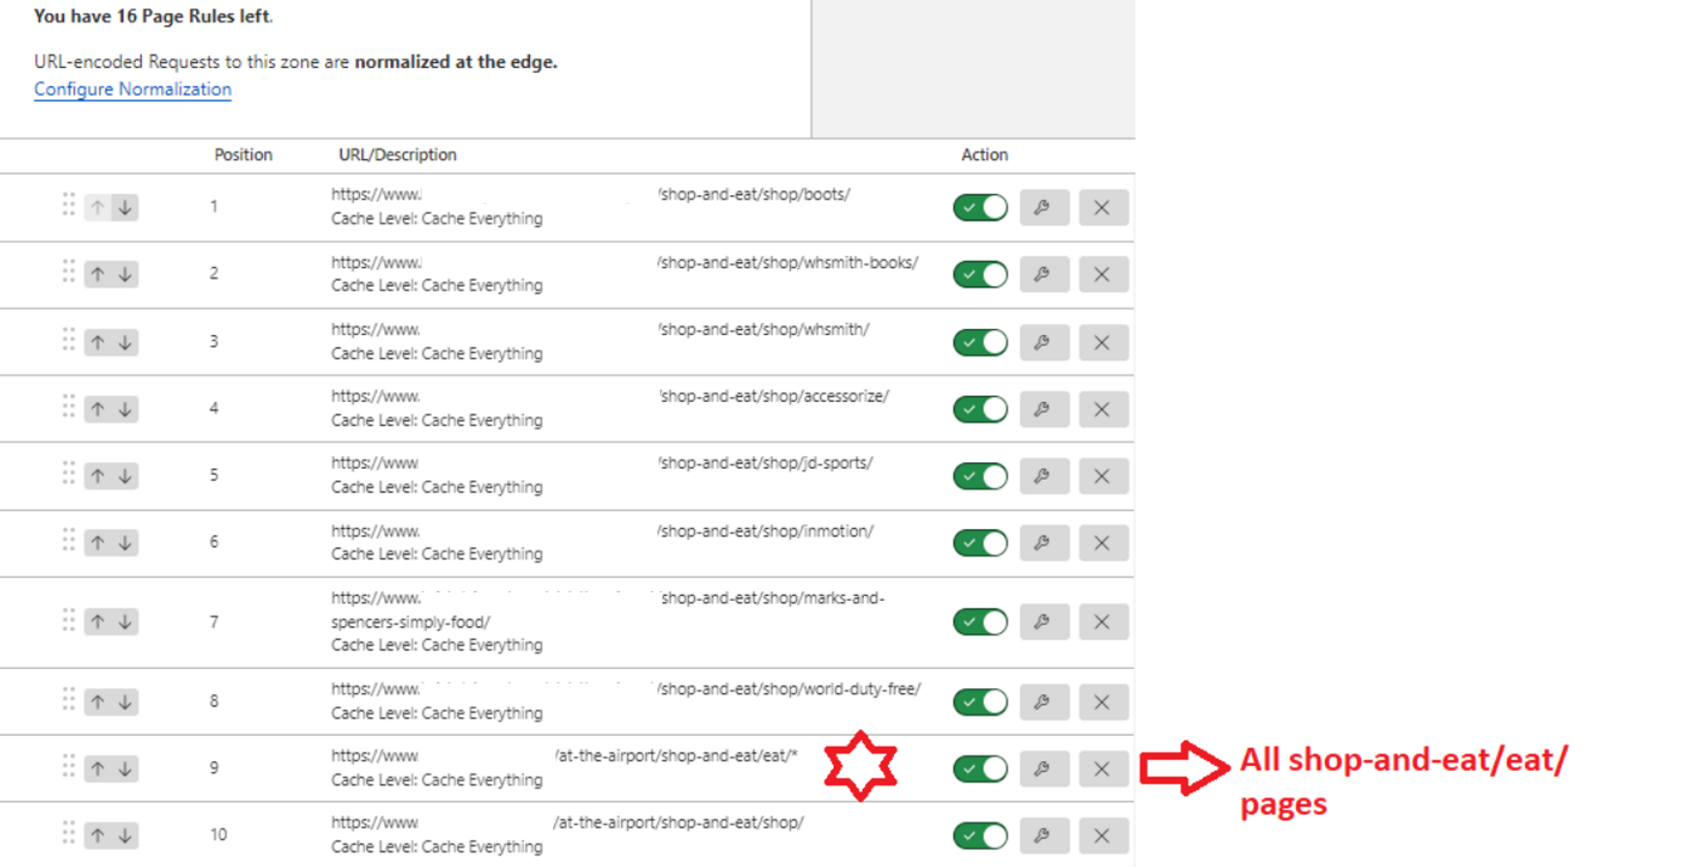
Page rules examples

Slide 41
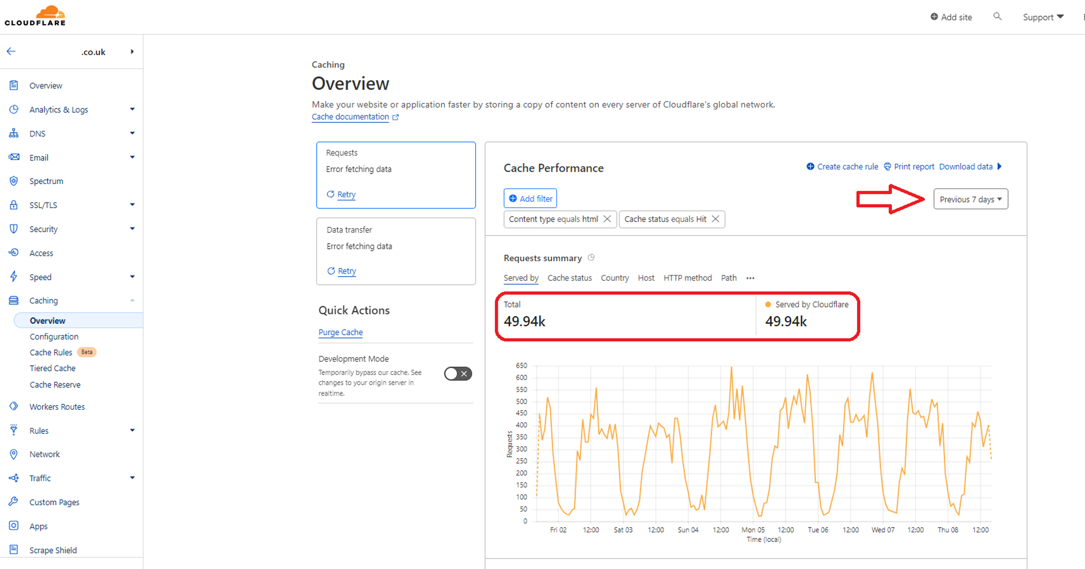
Caching overview
The pages that have CF page rules are served from CF cache, rather than the origin server.

Slide 42
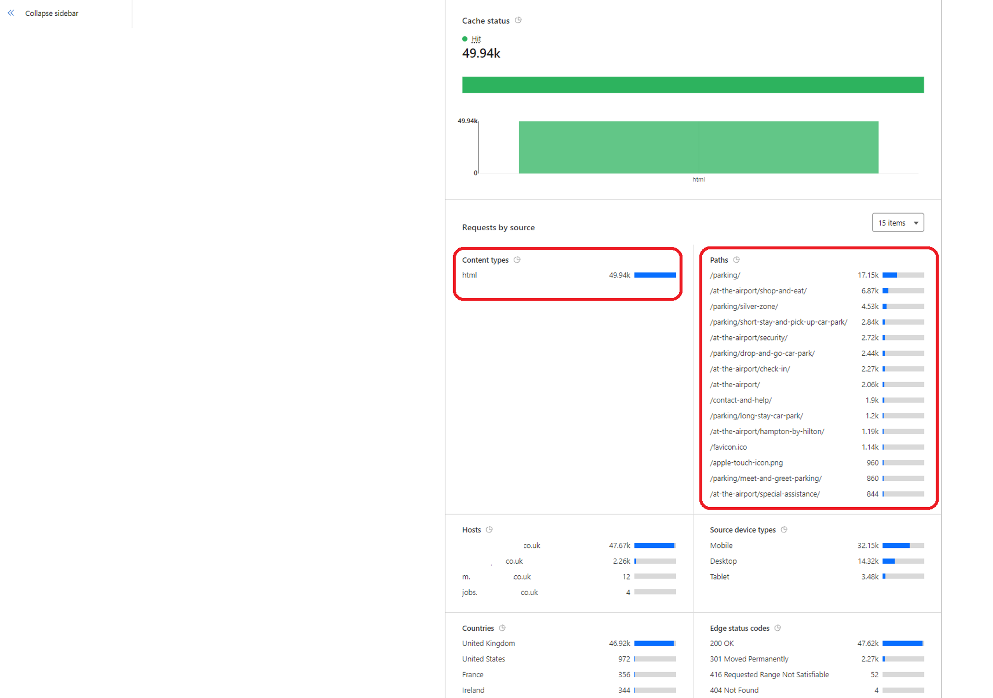
Caching overview

Slide 43
Integrating Umbraco with Cloudflare

Slide 44
Important notes and code changes
You can put CF in front of any website.
Whenever you update a webpage, you should clear the CF cache for that URL so that users can see the new information immediately.
Same rule applies for page deletion or unpublishing content etc.
You should do this programmatically using CF’s API.
Sample code can be found here: https://github.com/NurhakKaya/CloudflareUmbracoCMSPurgeCache

Slide 45
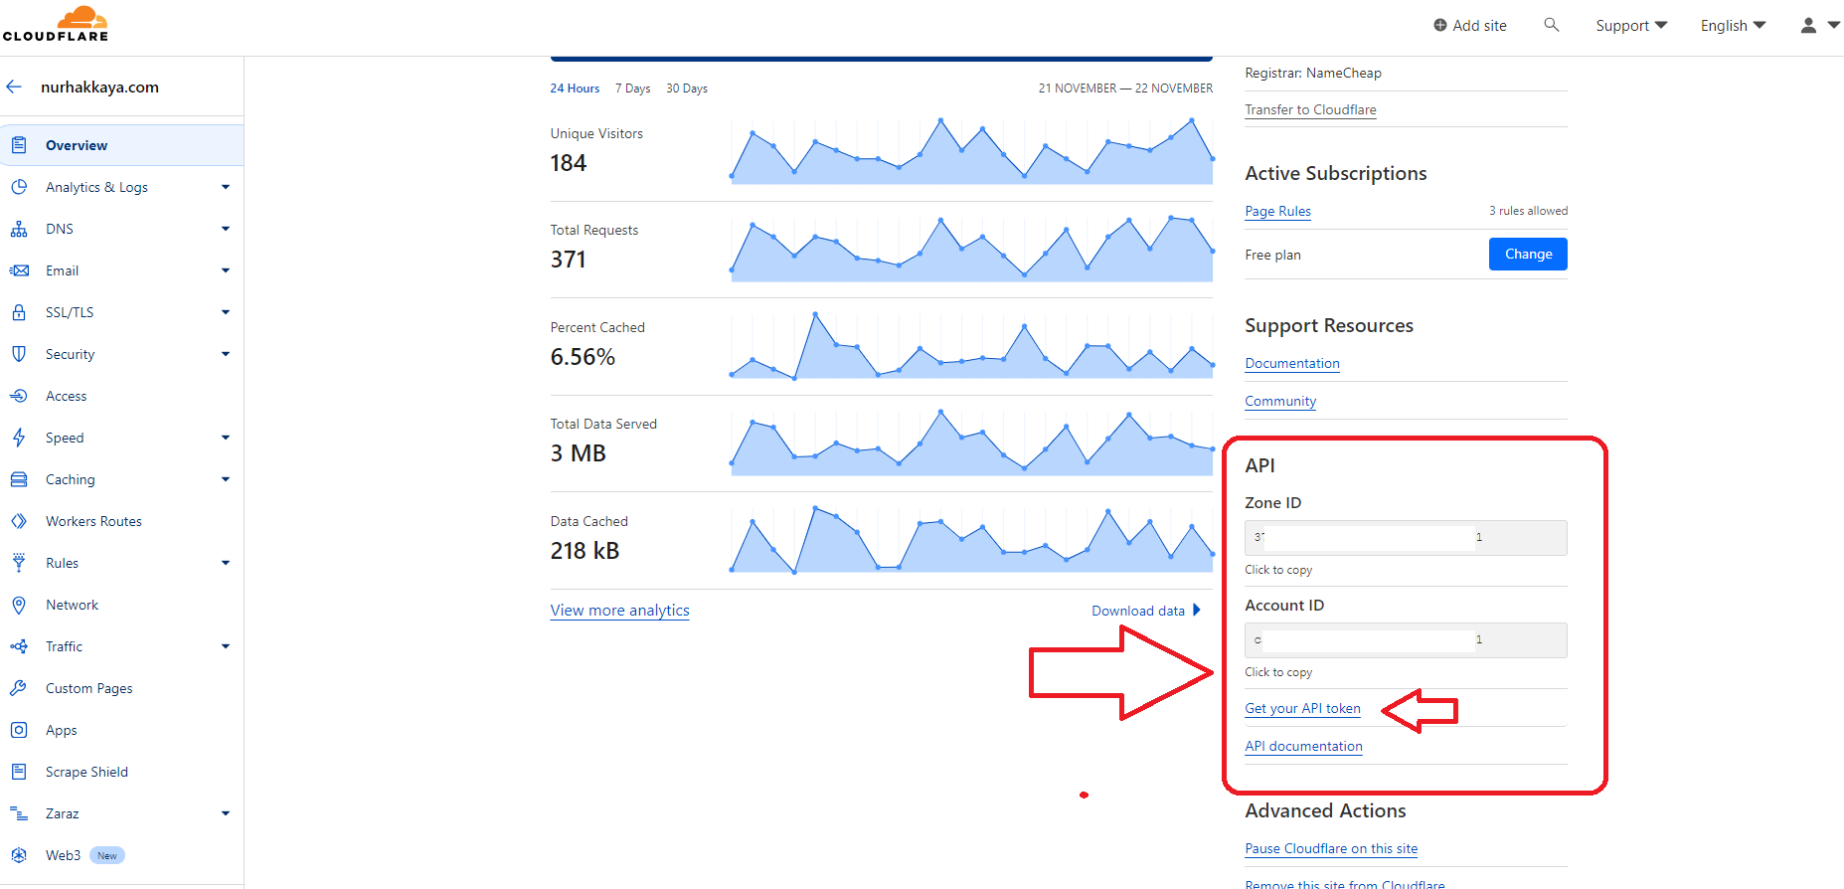
API Keys, Zone ID and Account ID

Slide 46
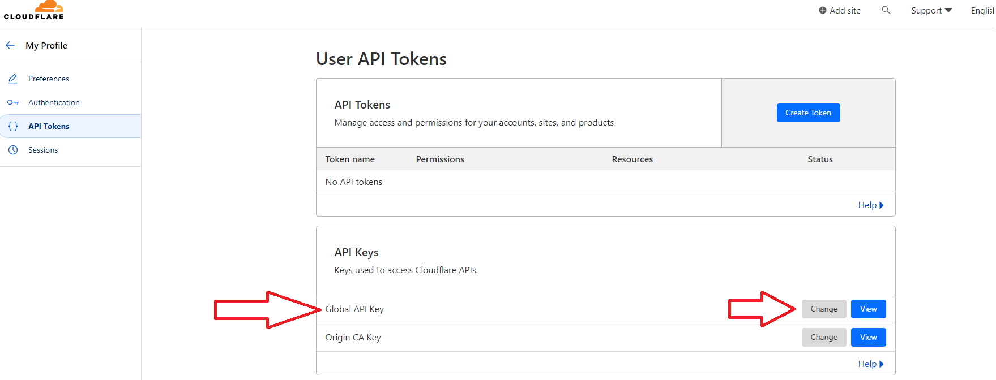
API Keys – Global API key

Slide 47
Final notes and future Umbraco upgrades

Slide 48
Final notes
Using a CDN service, like Cloudflare, is a no-branier for most cases.
With the correct setup, it can improve your website/app’s overall security and performance dramatically.
You can potentially save some time and money by reconfiguring your web/app server setup as CF will be handling some of the requests from its cache.
Notes:
more hardware drives (scale up/vertical scaling), adding more software nodes/instances (scale out/horizontal scaling)

Slide 49




Thank you for joining me today! #h5yr Any questions?
Nurhak Kaya
https://umbracocommunity.social/@nurhakkaya14
https://twitter.com/nurhakkaya14
https://www.linkedin.com/in/nurhak-kaya-53825051/
https://github.com/NurhakKaya

